Slide 1
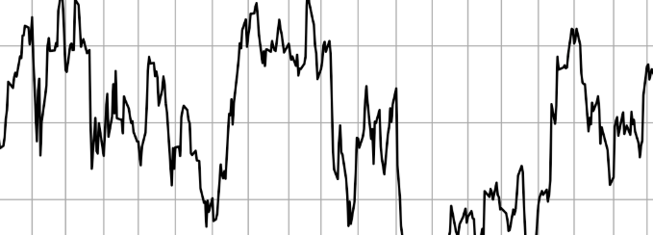

Deep Dive into the Hidden Links between Financial Statements and Portfolio Performance
Green Curry Fund – Team C42
| Devet Valecha| Fengquan Sun| Tony Gao | Tracy Pham | Yi Zhao |

Slide 2
Agenda
Business Understanding
Data Wrangling Process
Data Understanding and Exploration
Model Construction
Model Performance Evaluation
Deployment and Application

Slide 3
Agenda
Business Understanding
Data Wrangling Process
Data Understanding and Exploration
Model Construction
Model Performance Evaluation
Deployment and Application

Slide 4



Main Hypothesis – Why We Care?
It is possible to select an optimal portfolio of stocks from the NYSE that outperforms the S&P 500 using purely financial information extracted from SEC’s Form-10K.
This study has avoided the use of any information on firm’s industry classification (GICS) or sectors of operation.
Our Approach to the Project
Unsupervised Fundamental Analysis
Portfolio Selection and Performance Evaluation
Construction of Tangency Portfolio via MPT
* All assumptions of the MPT applies.

Slide 5
Agenda
Business Understanding
Data Wrangling Process
Data Understanding and Exploration
Model Construction
Model Performance Evaluation
Deployment and Application

Slide 6
Data Wrangling Process
Datasets
Variable Selection
Longitudinal Study
4
467
46
2012
2015
datasets selected incl. Prices_sa, Fundamentals, Rf &SP_daily
companies with complete daily returns across 1762 trading days
variables extracted from the balance sheet, income st. and st. of cash flows
Starting year for unsupervised learning and model construction
Ending year for unsupervised learning and model construction
Prices_sa: Split-adjusted daily stock prices
Fundamentals: Financial metrics from 10K
Rf: Daily return on the U.S. Treasury yields
SP_daily: Daily returns of the S&P 500 Index
Daily stock prices have been converted to returns and log-returns for the ease of analytical practice
No variable selection is required on risk-free return and S&P 500 return datasets
Missing data is either deleted or filled with input on a case-by-case basis
2016
Model performance evaluation against S&P 500 benchmark
6

Slide 7
Agenda
Business Understanding
Data Wrangling Process
Data Understanding and Exploration
Model Construction
Model Performance Evaluation
Deployment and Application

Slide 8
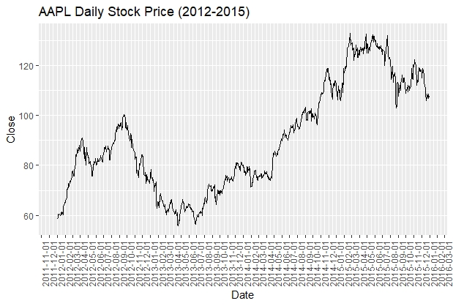
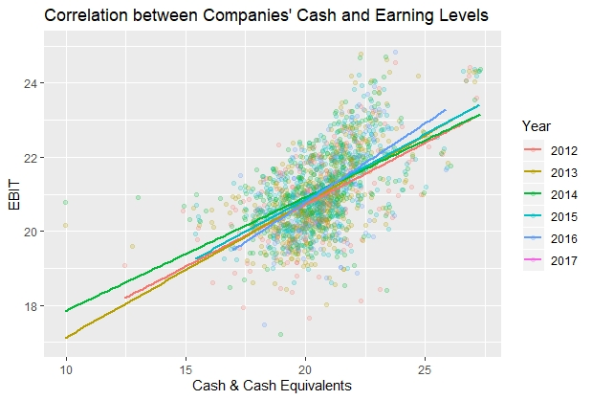
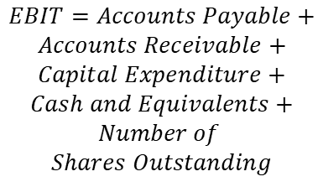


Data Understanding and Exploration
Variables | P-value
Intercept | 0.00518
AP | 4.56e-12
AR | 1.31e-05
CapEx | < 2e-16
Cash | 0.04510
# of Stock | < 2e-16
$$EBIT=Accounts Payable+$$
$$Accounts Receivable+$$
$$Capital Expenditure+$$
$$Cash and Equivalents+$$
$$Number of$$
$$Shares Outstanding$$
Prices are split-adjusted, no obviously signal of abnormal data points
Sept 2012: Before release of iPhone 5, high expectation, big disappointment in sales
Aug 2015: iPhone sales declined, longer update cycle, no longer the top pick in China
Cash and Earnings before Interest and Tax (EBIT) are two crucial indicators of company’s performance
A positive correlation is observed (as expected)
Companies have been most efficient in terms of converting available cash flows to EBIT, a proxy for net come, in 2016
$${Adj. R}^{2}=0.7368$$
$$Year=2014$$

Slide 9
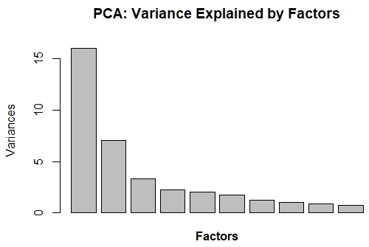
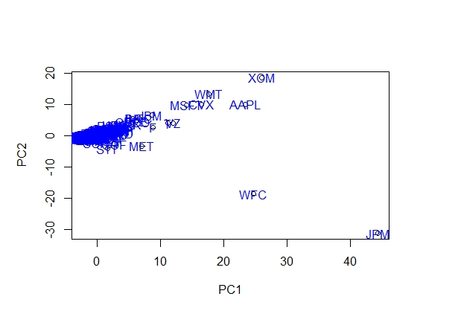
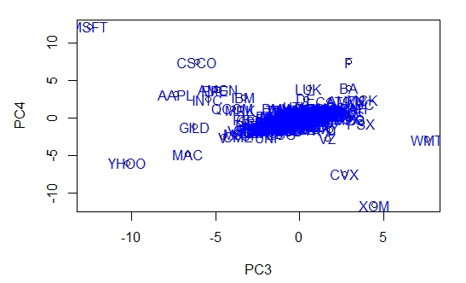
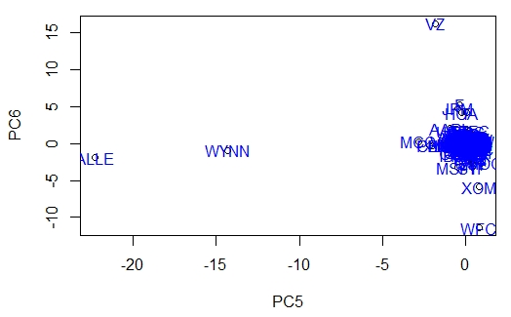
Principal Component Analysis (PCA) – E.g. Year 2014
75%
Year | PCA | Interpretation | Company Examples
2014 | 1 | Great performance, high earnings & cash flows | JPMorgan, Apple, ExxonMobile
2014 | 2 | Low debt level, minimal long term investments | Chevron, Microsoft, Walmart
2014 | 3 | Low operating margins, efficient production | Walmart, Phillips 66
2014 | 4 | Heavily invested in R&D | Microsoft, Cisco, Ford
2014 | 5 | Low score: High ROE, efficient operations | Wynn Resorts, Allegion
2014 | 6 | Low AR, high Interest payments & debt levels | Verizon, HCA Healthcare
Of the total variance explained by the top six PCs

Slide 10
Agenda
Business Understanding
Data Wrangling Process
Data Understanding and Exploration
Model Construction
Model Performance Evaluation
Deployment and Application

Slide 11
Model Construction
Clustering Analysis
PCA
Stepwise Regression
Euclidean Distance Matrix
Data Exploration
“K-means” Selection (AIC)
0-1 Matrix Conversion
Portfolio Selection by Clusters
Visualization with Network Data
Portfolio Selection
Modern Portfolio Theory (Markowitz, 1952)
Construction of Tangent Portfolio for Each Year (2012-2015)
Benchmark Comparison (S&P 500, 2016)
Portfolio Performance Evaluation
(2016)

Slide 12
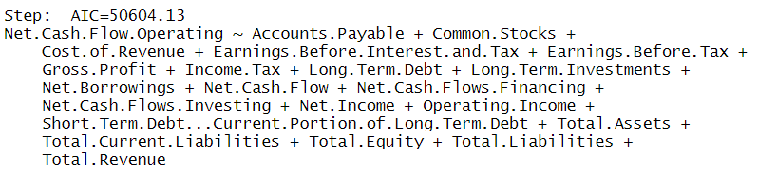
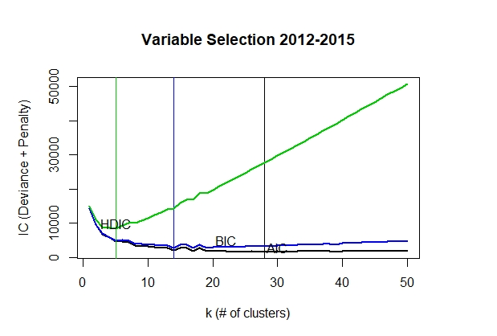
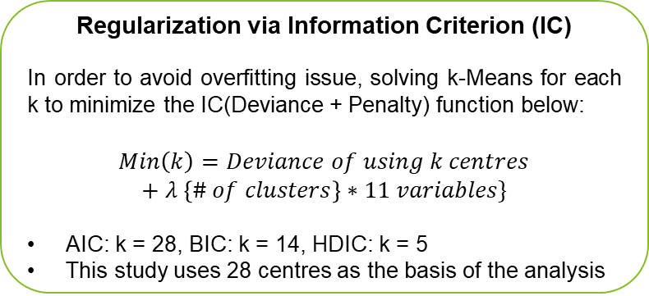
Variable and K-means Centre Selection
Stepwise Regression for Variable Selection
Regularization via Information Criterion (IC)
In order to avoid overfitting issue, solving k-Means for each k to minimize the IC(Deviance + Penalty) function below:
$$Min\left(k\right)=Deviance of using k centres$$
$$+ λ \left\{\# of clusters\right\}∗11 variables\}$$
AIC: k = 28, BIC: k = 14, HDIC: k = 5
This study uses 28 centres as the basis of the analysis
Procedure Summary
Net Operating Cash Flows as the response variable given its importance on company’s liquidity and overall financial health
Stepwise regression selects 21 explanatory variables with AIC = 50604.13 and R-squared = 99.88%
To avoid overfitting and multicollinearity concerns, further judgements are made based on team’s financial accounting literacy, e.g. Operating Income is removed from the regression given its high correlation with EBT, EBIT and Total Revenue
Final variables include: Accounts Payable, COGS, EBIT, Gross Profit, Long-term Debt, Long-term Investment, Net Cash Flow for Financing, Net Cash Flow for Investing, Short-term Debt to Long-term Debt Ratio, Retained Earnings and Short-term Investments

Slide 13
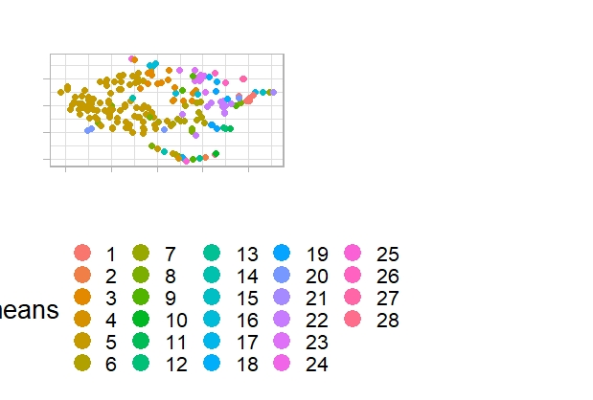
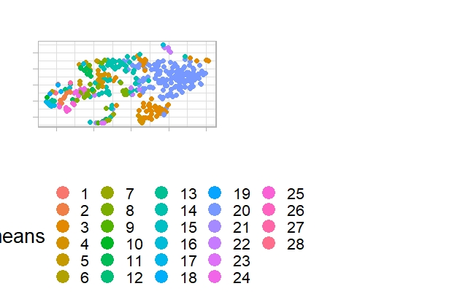
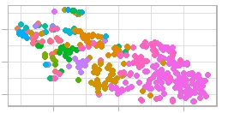
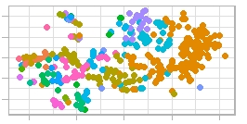
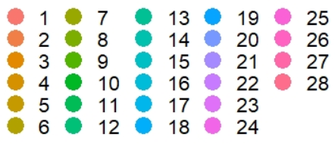
Clustering Analysis via Dimensionality Reduction Technique (2012-2015)
T-Distributed Stochastic Neighbor Embedding
A machine learning algorithm for visualization developed to embed high-dimensional data in a low-dimensional space. It models in such a way that similar companies are modeled by nearby companies.
Companies are grouped into 28 clusters each year
Each company has an 11D coordinate that has been reproduced on a 2D plot
2012
2013
T-SNE Plots
2015
2014

Slide 14
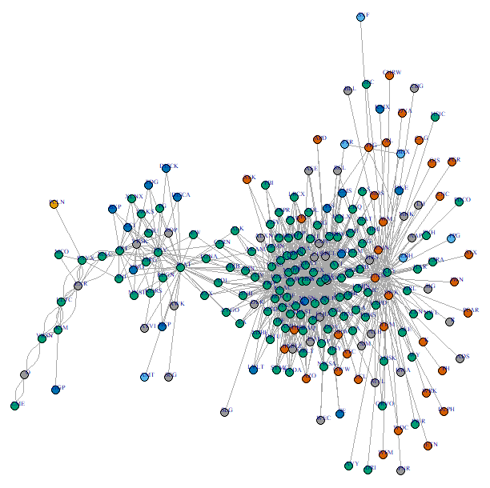
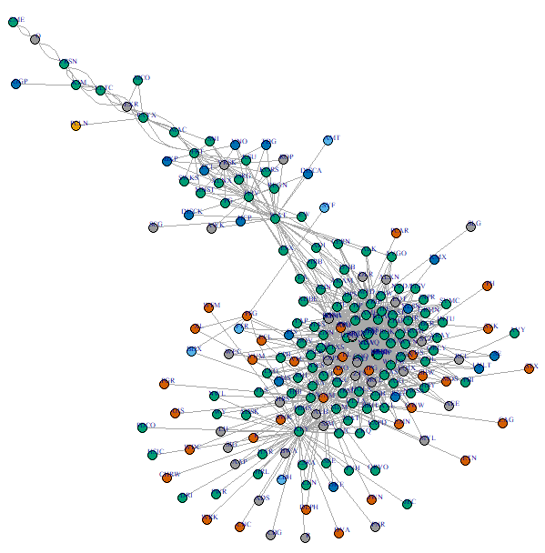
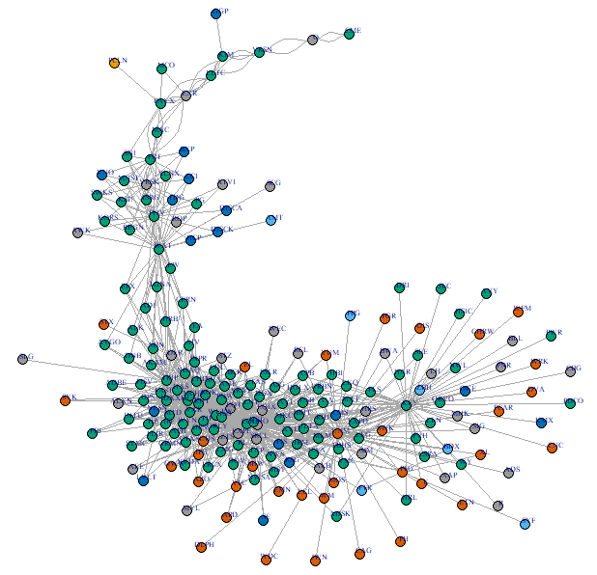
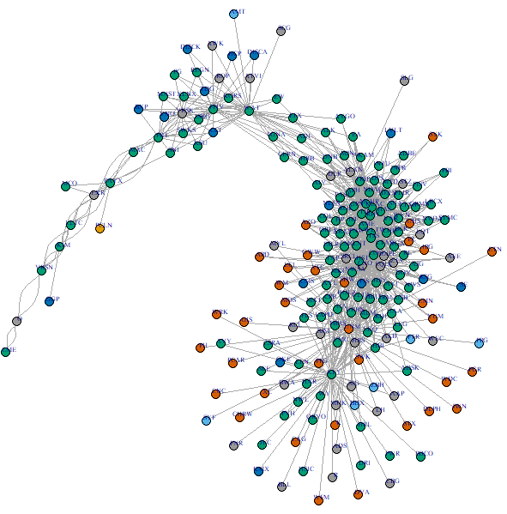
Visualization with Network Data (2012-2015)
2012
2013
Since each company could be represented by a 6-D coordinate as produced by the PCA, it is helpful to visualize the relationship between companies in each year for the enhancement of interpretation.
This is accomplished by calculating the pairwise Euclidean distance in the 6-dimensional space and then set a threshold to define a “close” relationship in terms of company profile similarity. Consequently, the Distance Matrix is transformed to a 0-1 Network Matrix.
Each year’s company network is then plotted on the left. Clustering analysis is used in combination by assigning a different color to each cluster of nodes. The plots model in such a way that similar companies are displayed by nearby companies.
1
2
2014
3
2015

Slide 15
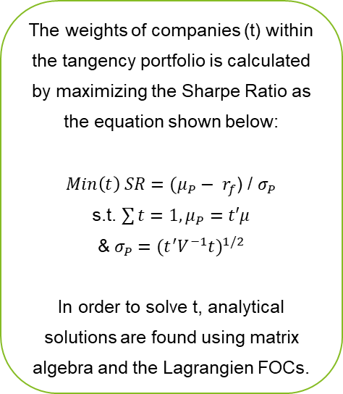
Portfolio Selection by Clusters (2012-2015)
Each year, companies are divided into 28 clusters. Each cluster represents a unique portfolio, returns of companies within the same portfolio are extracted to the same data frame
Expected returns and risks are calculated for each company. Then for each portfolio, expected returns and risks are calculated based on the tangency portfolio calculation outlined by the MPT, given the presence of the risk-free asset
The weights of companies (t) within the tangency portfolio is calculated by maximizing the Sharpe Ratio as the equation shown below:
$Min\left(t\right) SR=(μ_{P}− r_{f}$) / $σ_{P}$
s.t. $\sum{t}=1,μ_{P}=t′μ$
&$σ_{P}={{(t}^{′}V^{−1}t)}^{1/2}$
In order to solve t, analytical solutions are found using matrix algebra and the Lagrangien FOCs.
Trend 2
- 2012: 16 Companies
- 2013: 48 Companies
- 2014: 142 Companies
- 2015: MSFT
E.g. The optimal portfolio for 2012 contains 16 companies including CME, ZBH, UHS, CF, GWW, ATVI, DGX, HSY, MAT, VFC, ECL, SHW, ORLY, GPC, YUM & TXT
All available portfolios are visualized on the risk-return graph. Portfolios that contain only a single company are eliminated (exception – 2015 MSFT). Given the presence of the risk-free asset, optimal portfolio for each year is selected based on the maximization of the slope. Results are compared with the S&P 500 Index on the graph.

Slide 16
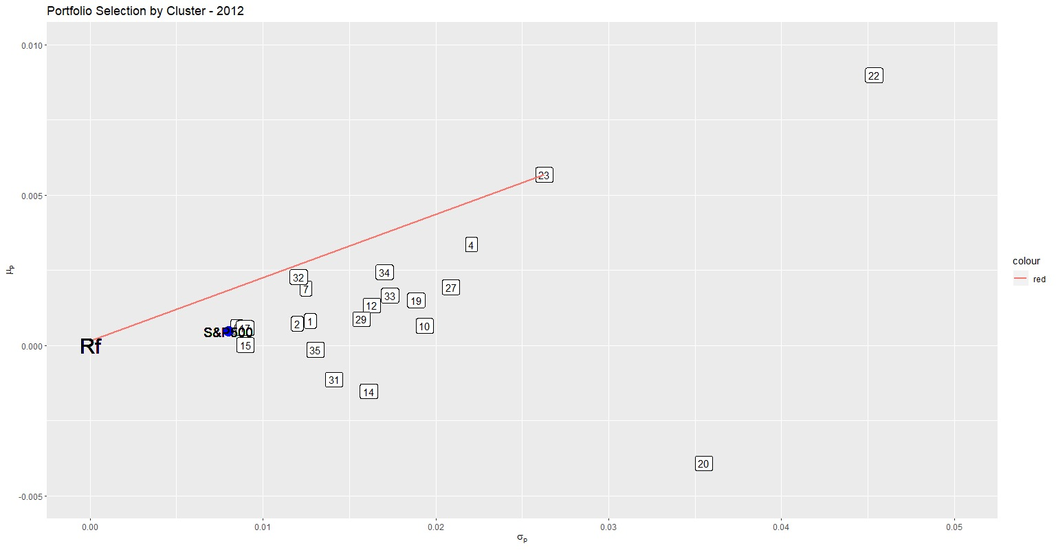
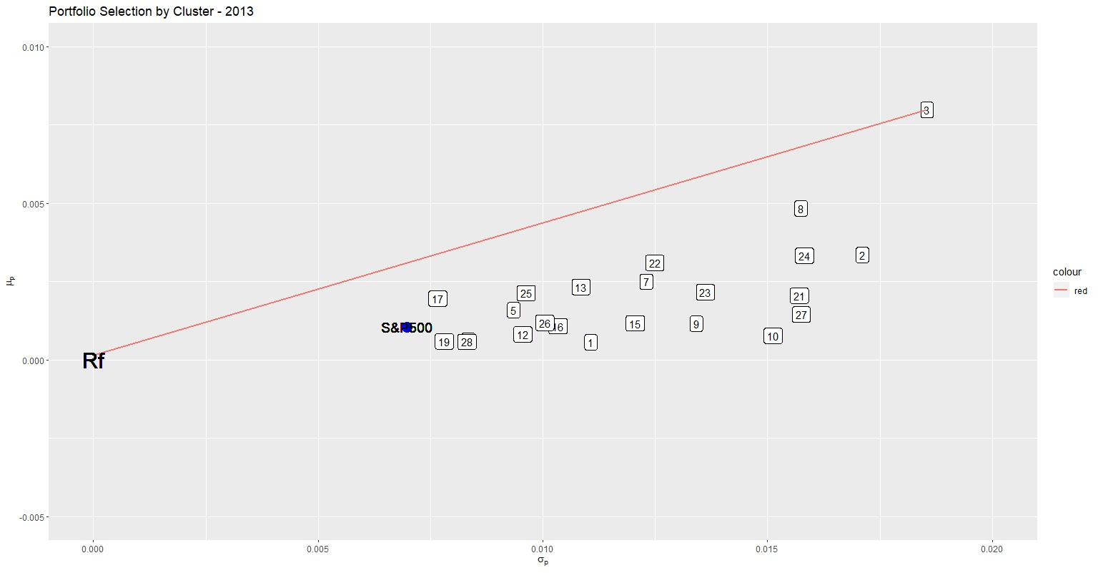
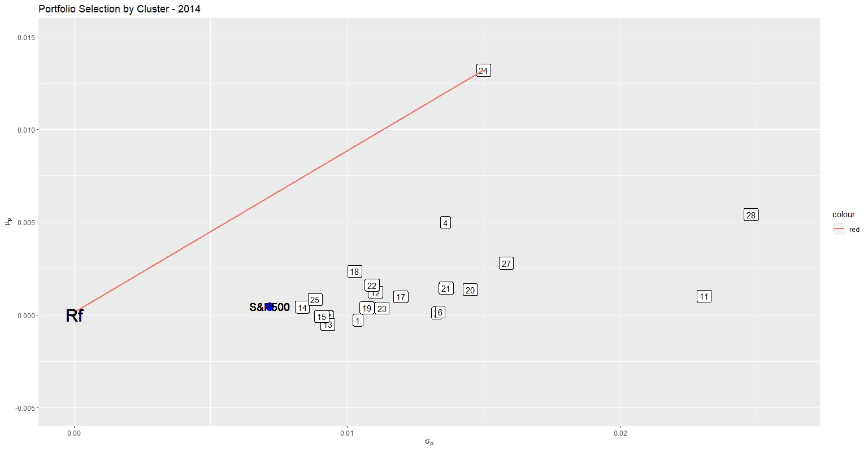
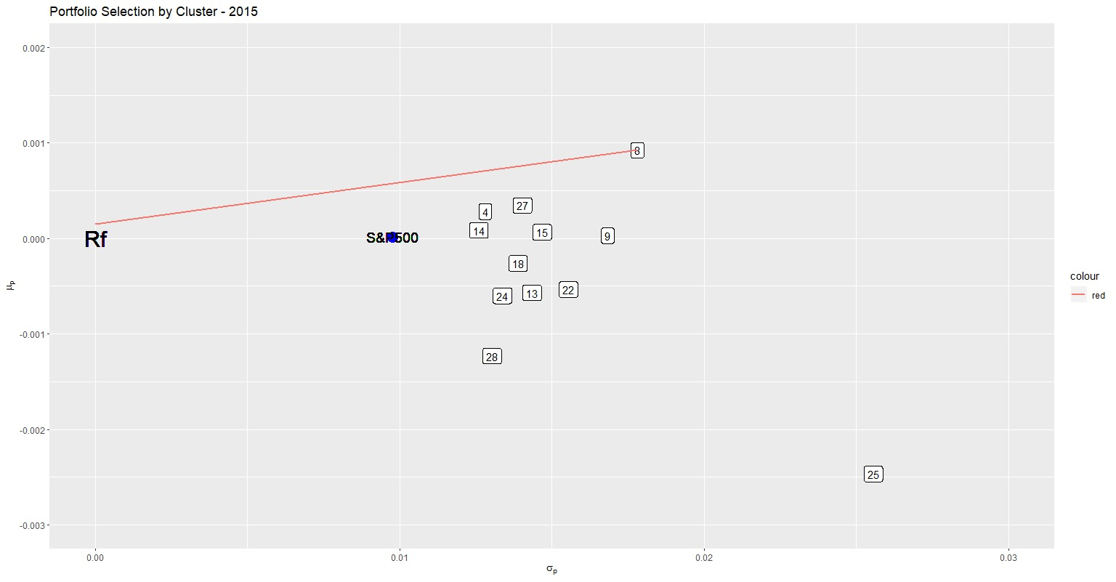
Portfolio Selection by Clusters (2012-2015)
Portfolio 23
Portfolio 3
Portfolio 24
Portfolio 8

Slide 17
Agenda
Business Understanding
Data Wrangling Process
Data Understanding and Exploration
Model Construction
Model Performance Evaluation
Deployment and Application

Slide 18
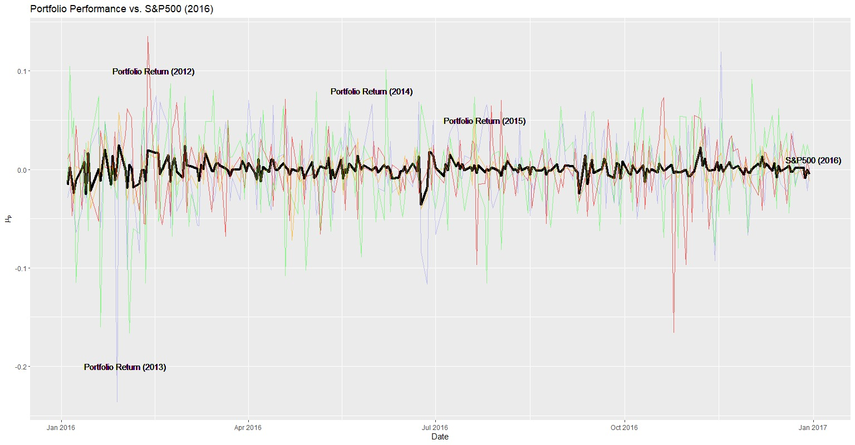
Model Performance Evaluation (2016)
Four optimal portfolios as illustrated before
Evaluation of optimal portfolios with benchmark in 2016
01
Optimal portfolio in 2012 (23)
02
Optimal portfolio in 2013 (3)
03
Optimal portfolio in 2014 (24)
04
Optimal portfolio in 2015 (8)
05
Benchmark: S&P 500
Model Performance Evaluation
Four historical optimal portfolios are chosen to simulate their daily returns in 2016
Simulation of portfolio returns is achieved using the calculation:
S&P 500 has a short-term expected return of approximately 0
Four historical optimal portfolios have great volatilities
Portfolio 2013 and Portfolio 2015 outperform the S&P 500 in 2016

Slide 19
Agenda
Business Understanding
Data Wrangling Process
Data Understanding and Exploration
Model Construction
Model Performance Evaluation
Deployment and Application

Slide 20

Deployment and Application
Deployment
Potential Risks
Transaction and agency costs are excluded
Selecting optimal portfolios based on historical financial performance of companies listed on the NYSE
No strong evidence that financial profile is a good indicator to define the similarity among stocks, further considerations include testing the algorithm within each industry segmentation of stocks
Less effort than traditional portfolio
optimisation methods
Eliminating the influence of biases by asymmetric information
Multi-period cumulative portfolio selection method ought to be considered in further research
20

Slide 21
Thank You

